Slide 1
Super Resolution of occluded or unclear faces
using Generative Adversarial Networks
Akhil Nair | Mounica Subramani | Mrinal Soni | SuRui Yang

Slide 2
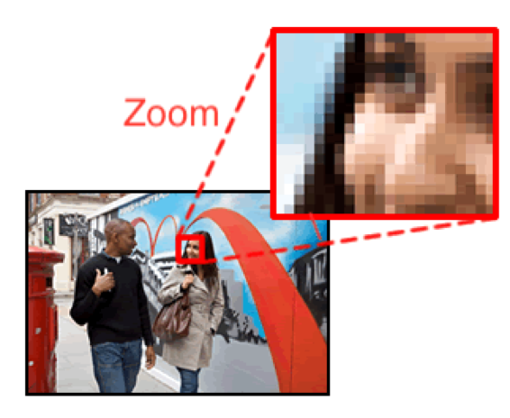
Introduction
Challenge: Inability to capture perceptually satisfying features in an image.
Goal: Reconstruct high quality images, ensuring perceptual quality is preserved.
PROBLEM STATEMENT:
Generate a super resolution image from Generator and feed it to Discriminator to classify it.
Improve the existing implementation of GAN to get better super resolution images out of generator.
Low-resolution
Super-resolution
High-resolution
low-resolution
high-resolution
Notes:
Super resolution of unclear or occluded faces using generative adversarial networks.
I will briefly describe what the problem statement is and what we are aiming to do.
Basically Image or video data contain plenty of information and have wide range of applications in the field of research and development.
Many applications require zooming of a specific area in the image where HR becomes essential eg. tumors diagnosis, visual surveillance etc
No matter how well an upscaling algo performs, there will be some amount of info lost and drop in image quality.
An efficient fix for certain situation deserves high attention that is when SRGAN comes into picture.
Gan is a generative adversarial network with two deep neural nets within , they are generator and discriminator.
The generator takes in low resolution image as input and learns all the features from the low-resolution image and tries to create a possible super resolution image. On repetitive training and learning of the generator, it comes close to producing a good super resolution image.
Estimating a high-resolution image from its low-resolution counterpart is referred to as super-resolution.
This generated fake SR image is fed into the discriminator alongside a stream of original HR Image taken from the actual, ground-truth dataset.
The discriminator is a normal (and well understood) classification model.
The discriminator takes in both HR and SR image and returns probabilities, a number between 0 and 1, with 1 representing real and 0 representing fake.
In this project, we aim to explore image super-resolution using generative adversarial networks, trying to minimize detail lost during the upscaling procedure.
Problem statement : In a nutshell, we are trying to generate a SR image from generator and then feed it to discriminator along with original HR images to classify them.
For the second phase.. The images are replaced by video frames.

Slide 3
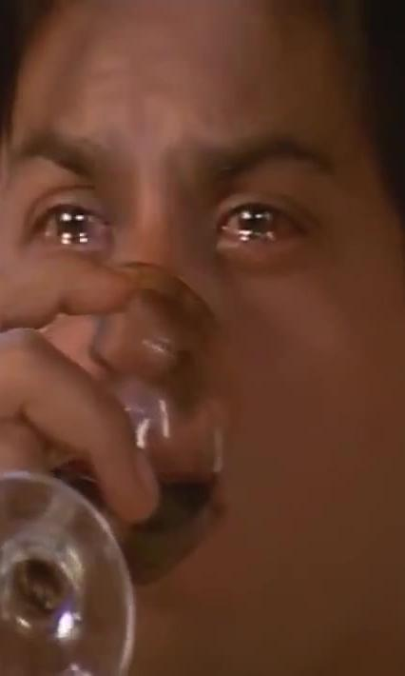
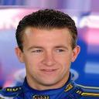

Dataset for First Phase
The CelebA dataset consists of 202,599 face images of 10,177 unique identities
Images are frontal images with less occlusion and mostly clear faces
To avoid bias we would train our model on a second dataset Indian Movie Face Database
The dataset contains 34512 images of 100 actors collected from 100 videos
Notes:
For the first phase of the project we have used Celeb-A data set and to avoid bias,
we used Indian movie face database which had lot of diversity in pose, expression, occlusion and resolution.

Slide 4
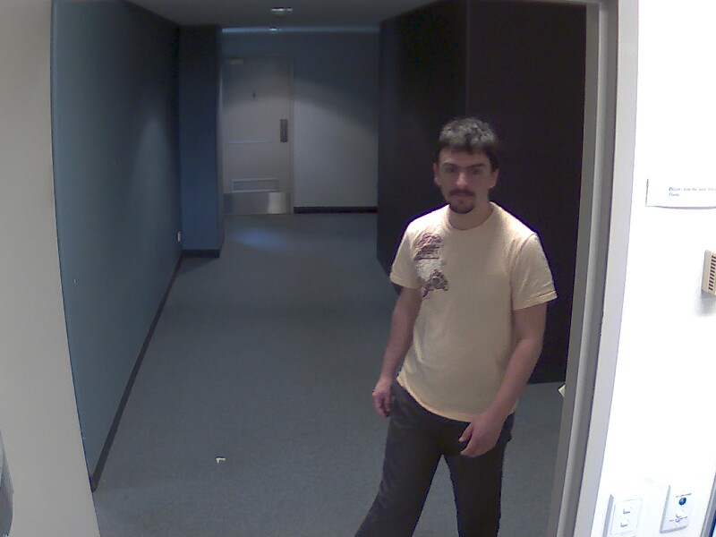
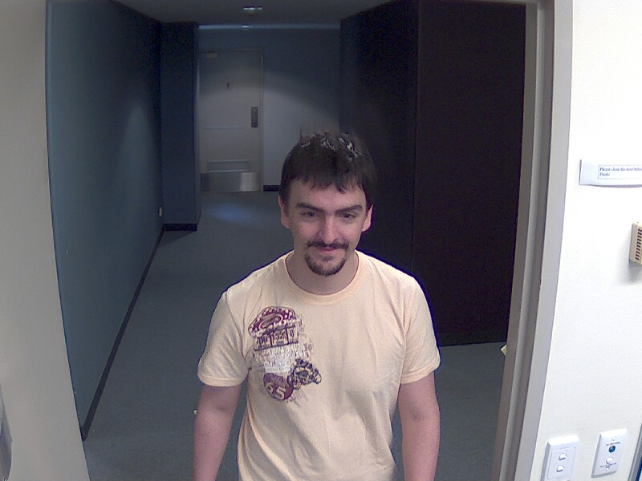
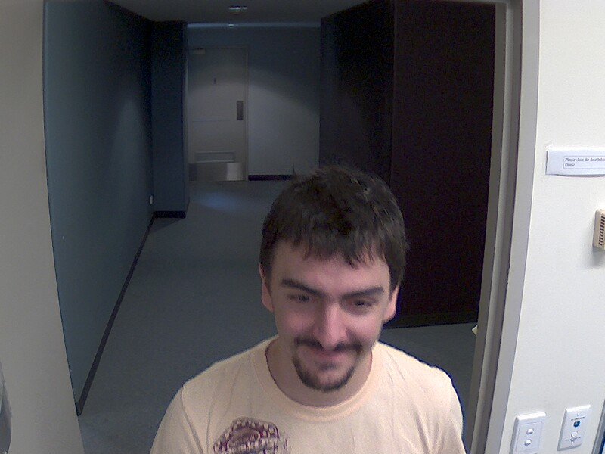
Dataset for Second Phase
The ChokePoint Dataset dataset is a video dataset consists of 48 videos, simulating real-world surveillance conditions using existing technologies.
We choose one of the video that captures subjects walking towards a door in an indoor environment.
We extracted 1500 frames from this video by 30 FPS.
Notes:
ChokePoint is a video dataset.
It is mainly meant for experimenting person identification or verification under real world surveillance conditions.
So basically, we have array of cameras, placed at different portals or areas to capture subjects walking through each portal.
here just three cameras are used to capture the subjects walking towards a door in an indoor environment.
Faces in these video dataset has variations in terms of pose, sharpness, occlusion and they also have misalignment.
This will help in avoid model bias
There are a total of 48 videos, and we took 1 for training our model.
We have taken a 30 frames per second video and extracted 1500 frames out of it.

Slide 5
Generative Adversarial Network
Network Functions: Batch Normalization
Why？
A common failure mode observed in GANs is the problem of internal covariate shift, small changes in shallower hidden layers will be amplified as they propagate within the network, resulting in significant shift in deeper hidden layers.
How？
Normalize the input to each unit to have zero mean and unit variance
Effect
Deal with training problems that arise due to poor initialization and helps gradient flow in deeper models.

Slide 6
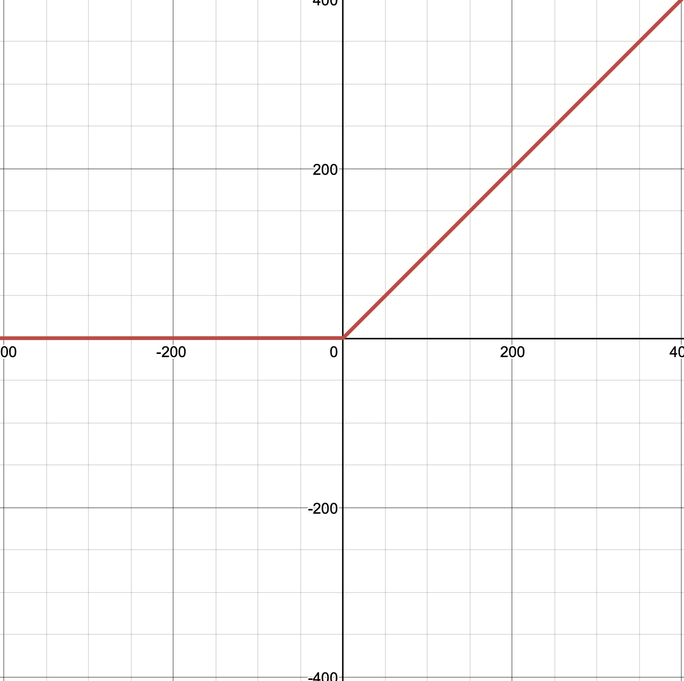
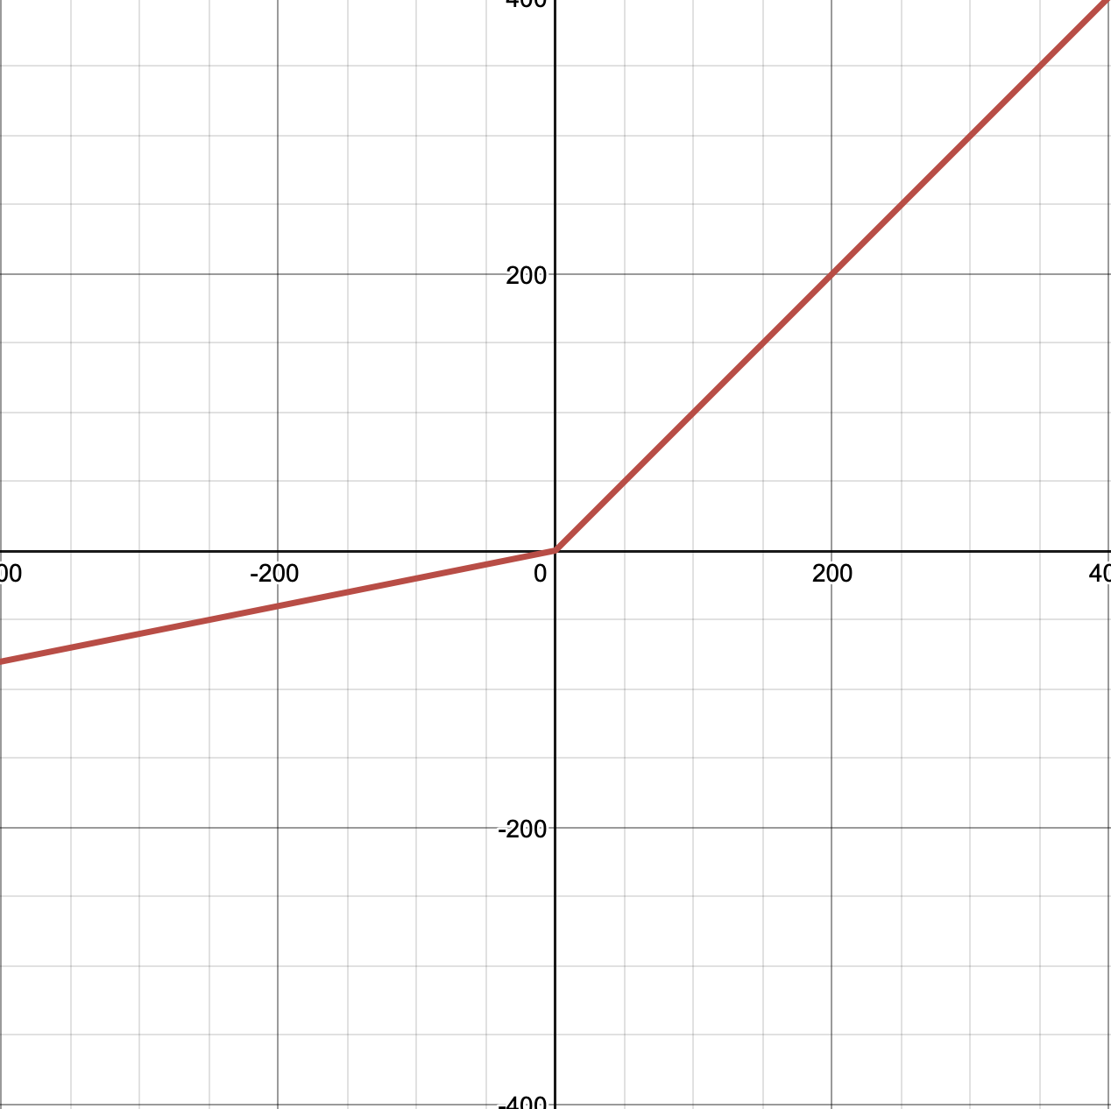
Generative Adversarial Network
Network Functions: Leaky ReLU & Parametric ReLU
why?
The motivation of L/PReLU is to avoid zero gradients, which
fixes the “dying ReLU” problem
Both speed up training
Difference
PReLU adaptively learns the parameters of the rectifiers,
and improves accuracy at negligible
extra computational cost
If a is a small and fixed value, PReLU
becomes the Leaky ReLU
f(y)=y
f(y)=y
f(y)=0
f(y)=ay
ReLU
Parametric ReLU

Slide 7
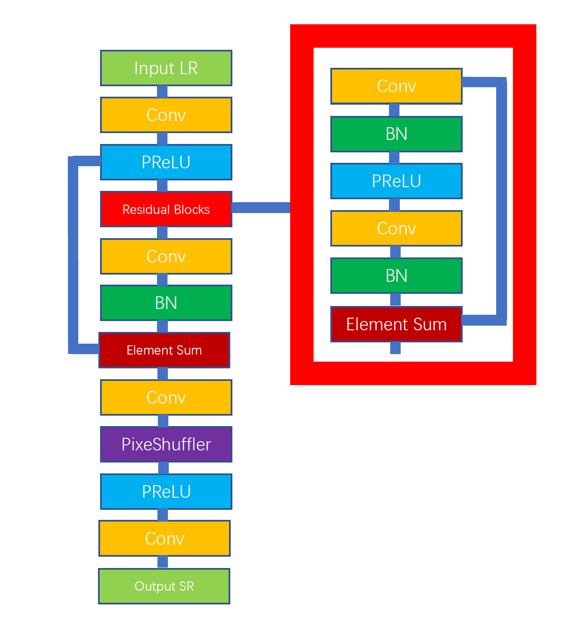
Generator
Skip connection
Feed deeper network by previous
Layer, avoiding vanishing gradient
PixeShuffler
Upsample input by factor of 2,
Making sure final output dimension
Skip connection
Skip connection

Slide 8
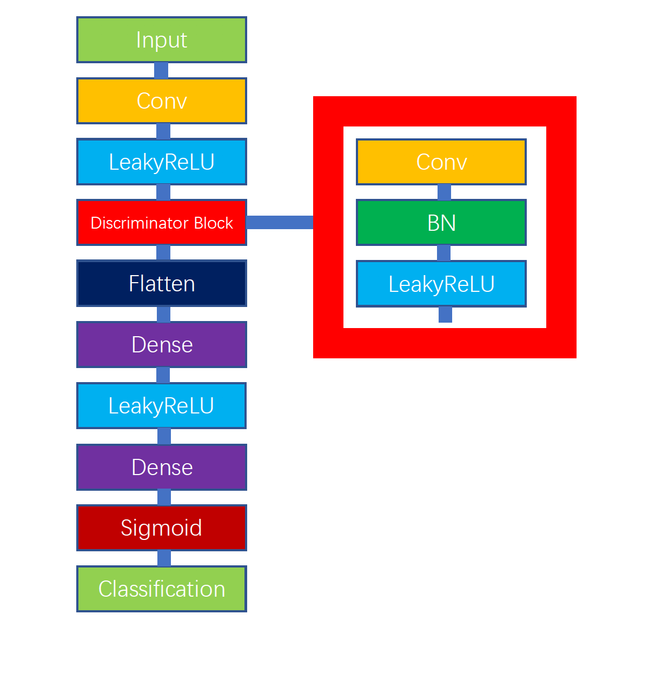
Discriminator
Flatten
Break the spatial structure of the data and
create a single long feature vector to be
used by the dense layer
Dense layer
Find patterns for discriminating in pixel
values that given as input

Slide 9
Preprocessing
Downsampling – We used LANCZOS algorithm to generate low-resolution images by down-sampling high-resolution images
Normalization – The pixel values are normalized to a range of (-1) to 1.
Batching – The features (low-resolution images) and labels (high-resolution images) are zipped together and then batched.
Feed input to tensorflow model.

Slide 10
Generator model building
1.4M Trainable Parameters
Model fed with low resolution Images
13M trainable parameters
Model fed with output of generator and high-resolution images
Discriminator model building

Slide 11
Model Training (Phase 1)
Reduction in training size – The training size was reduced keeping in mind the computational restrictions of running locally.
The training rate was around 12 hours per 100 iterations.
Model weights and predicted images were periodically saved.
Model training in phase 2 was facilitated by migrating existing implementation of the model in AWS.
Model Training (Phase 1I)

Slide 12


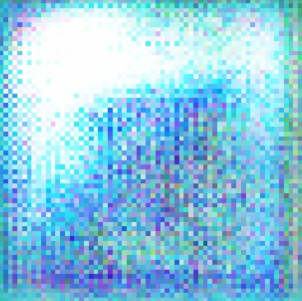
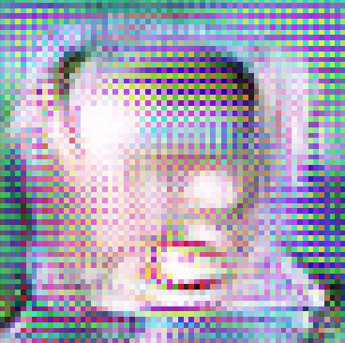

Results and Conclusion, First Phase
High Resolution Image
Low Resolution Image
Super Resolution Image Iteration 1
Super Resolution Image Iteration 100
Super Resolution Image Iteration 500

Slide 13
AWS Implementation
The model implementation was migrated to AWS for scalability and performance.
We used the AWS Deep Learning AMI (DLAMI) in an EC2 instance(GPU) of type p2.xlarge (4 cores, 61 GB memory)
Phase 1 Dataset was re-run in AWS for 3000 iterations ~ 60 hours
Phase 2 Dataset was run in AWS for 5000 iterations ~ 45 hours

Slide 14

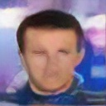



Results: First Phase Improvement
All generated images were the result of 3000 iterations of the model
64 * 64 (High)
32 * 32 (Low)
64 * 64 (Generated)
128* 128 (Generated)
128 * 128 (High)
64 * 64 (Low)
128 * 128 (Generated)
256 * 256 (Generated)

Slide 15
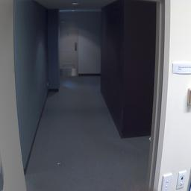
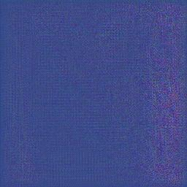
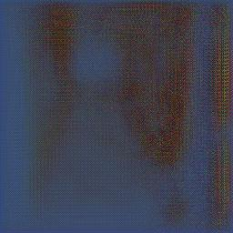
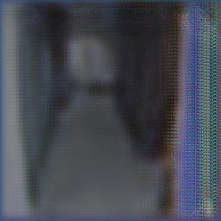
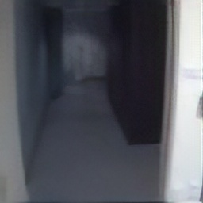
Results: Second Phase
Frames were generated and combined using a command line tool ffmpeg.
True High-Resolution Image
Iteration 0
Iteration 100
Iteration 1000
Iteration 5000

Slide 16
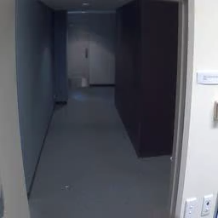

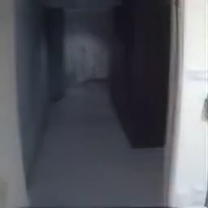
Results: Second Phase
High Resolution
Low Resolution
Generated High Resolution

Slide 17
Conclusions
From the results of Phase 1 and Phase 2 we saw that the model performance is good when the initial low-resolution image is not extremely low
The model learning is low from 2x to 4x upscaling
The learning rate of the model decreases considerably after initial 1000 iterations
Video Super-resolution is computationally very expensive even with AWS
During video super resolution we found that the GAN model had trouble with far off background in the frames.

Slide 18
Future Work
Further work is needed in video super resolution to make the faces clear enough for facial recognition
Facial recognition model coupled with a classification model would be used for demographic classification
Would like to try a variation of GAN called DCGAN, has shown some excellent results recently

